Slide 1
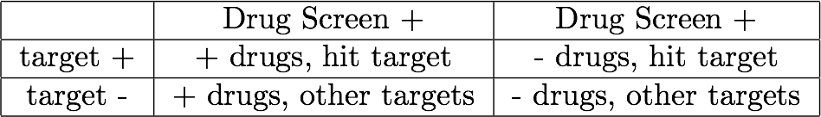
Drugbank target enrichment, FDA screen
640 drugs screened
63 positive drugs (>0 larva)
16 drugs >=6 larvae
5 drugs >=7 larvae
Drug targets obtained for 395 drugs from drugbank.ca target list
44/63 positive drugs matched to targets
11/16 drugs with >=6 larvae matched to targets
4/5 drugs with >=7 larvae matched to targets
Testing for enrichment:
For each drug target, construct following 2x2 table
Obtain OR, P-value
FDR correction on list of P-values for all targets

Slide 2
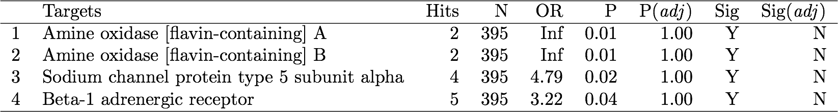
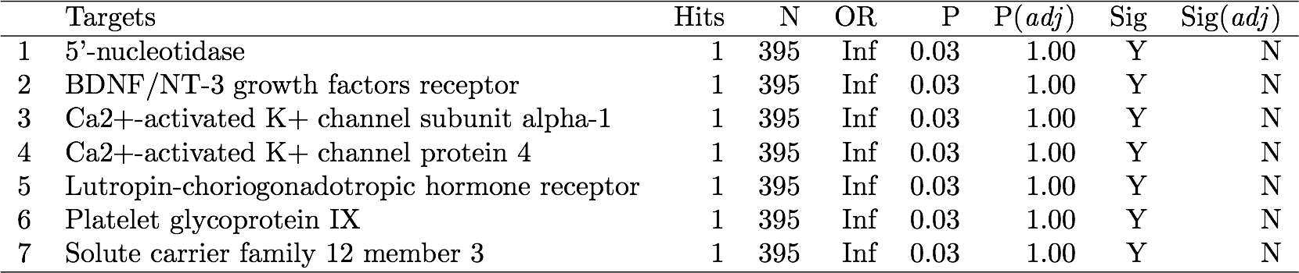
Targets for all positive drugs:
Targets for drugs with >=6 larvae

Slide 3
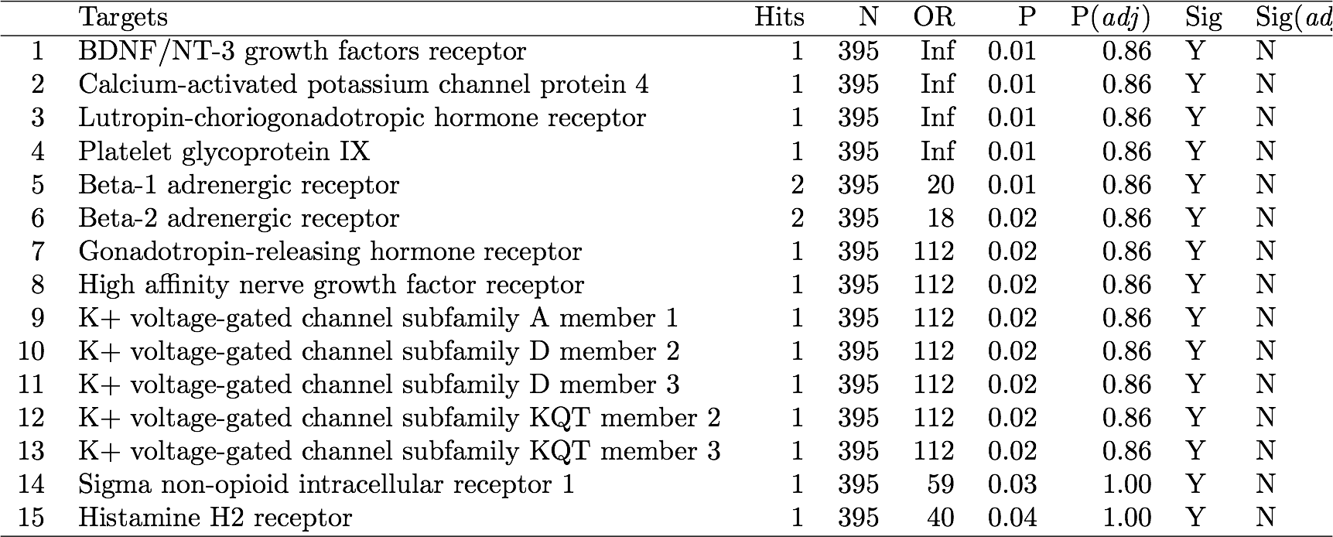
Targets for drugs with >=7 larvae

Slide 4
Networks
Eric sent 7 bayesian networks from a variety of tissues:
PF_AD_links_for_cytoscape.txt
PF_normal_links_space_delimited.txt
delimited_blood_network.txt
delimited_pan_intestine_network.txt
delimited_risk_network.txt
ileum_links_space_delimited.txt
omental_links_space_delimited.txt

Slide 5
Network Workflow
Networks from Eric
RASopathy Genes (15)
Annotation
Identify Subnetworks
Pathways enriched in subnetworks
GO, KEGG
CMAP
GEO
MSigDB
NextBio (?)
1. Relate drug screen to networks
2. Use networks to predict new drugs
Identify Key Driver Nodes in Subnetworks

Slide 6
Subnetwork Identification
Layer = 1
Layer = 2
Identify all nodes within a “layer” n of nearest neighbors and call that the subnetwork of layer n
Layer = 3
Are these subnetworks actually enriched for RASopathy genes?
Hypergeometric test:
Full set of genes = baseline
Full set of RAS genes = subtype of interest
Subnetwork = sample
RAS genes in subnetwork = what we are looking at for enrichment

Slide 7
Network | Layer | Total Nodes | n RAS, Best Subnetwork | n RAS in Network | n non-RASin Network | Size of Best Subnetwork | P
PF_normal_links_space_delimited.txt | 2 | 26 | 1 | 5 | 7530 | NA | 1
PF_normal_links_space_delimited.txt | 3 | 78 | 1 | 5 | 7530 | NA | 1
PF_normal_links_space_delimited.txt | 4 | 186 | 2 | 5 | 7530 | 36 or 145 | 9.95E-07
PF_normal_links_space_delimited.txt | 5 | 376 | 4 | 5 | 7530 | 341 | 1.85E-07
PF_AD_links_for_cytoscape.txt | 2 | 91 | 3 | 5 | 7115 | 62 | 2.59E-08
PF_AD_links_for_cytoscape.txt | 3 | 297 | 5 | 5 | 7115 | 297 | 0
PF_AD_links_for_cytoscape.txt | 4 | 863 | 5 | 5 | 7115 | 863 | 0
PF_AD_links_for_cytoscape.txt | 5 | 2149 | 5 | 5 | 7115 | 2149 | 0
omental_links_space_delimited.txt | 2 | 224 | 5 | 5 | 7596 | 224 | 0
omental_links_space_delimited.txt | 3 | 902 | 5 | 5 | 7596 | 902 | 0
ileum_links_space_delimited.txt | 2 | 99 | 1 | 10 | 8372 | 6 | 1.92E-05
ileum_links_space_delimited.txt | 3 | 204 | 2 | 10 | 8372 | 61 | 4.24E-05
ileum_links_space_delimited.txt | 4 | 368 | 3 | 10 | 8372 | 82 | 1.71E-06
ileum_links_space_delimited.txt | 5 | 579 | 3 | 10 | 8372 | 265 | 0.000176459
delimited_risk_network.txt | 2 | 293 | 10 | 10 | 7556 | 293 | 0
delimited_risk_network.txt | 3 | 960 | 10 | 10 | 7556 | 960 | 0
delimited_pan_intestine_network.txt | 2 | 295 | 10 | 11 | 7787 | 286 | 1.11E-16
delimited_pan_intestine_network.txt | 3 | 1154 | 11 | 11 | 7787 | 1154 | 0
delimited_blood_network.txt | 2 | 113 | 2 | 12 | 7941 | 7 | 9.16E-08
delimited_blood_network.txt | 3 | 235 | 2 | 12 | 7941 | 21, 44, or 103 | 3.44E-06
delimited_blood_network.txt | 4 | 408 | 2 | 12 | 7941 | 76 or 153 | 0.000173432
delimited_blood_network.txt | 5 | 678 | 7 | 12 | 7941 | 502 | 9.43E-08
delimited_blood_network.txt | 6 | 1032 | 9 | 12 | 7941 | 876 | 1.34E-08
Notes:
Hypergeometric distribution: Probability of drawing a given number of white marbles in a random sample taken from a jar of mixed white and black marbles without replacement
Not a random sample
Do these p-values make sense?

Slide 8
Key Driver Analysis
keydriver R package (2008)
Important parameters:
Layer of subnetwork to construct
Directed or undirected subnetworks
Undirected expansion = nearest neighbors layers
EnrichedNodesPercentCut, boostHubs, dynamicSearch values left as default
Unsure how tuning these parameters will affect the output

Slide 9
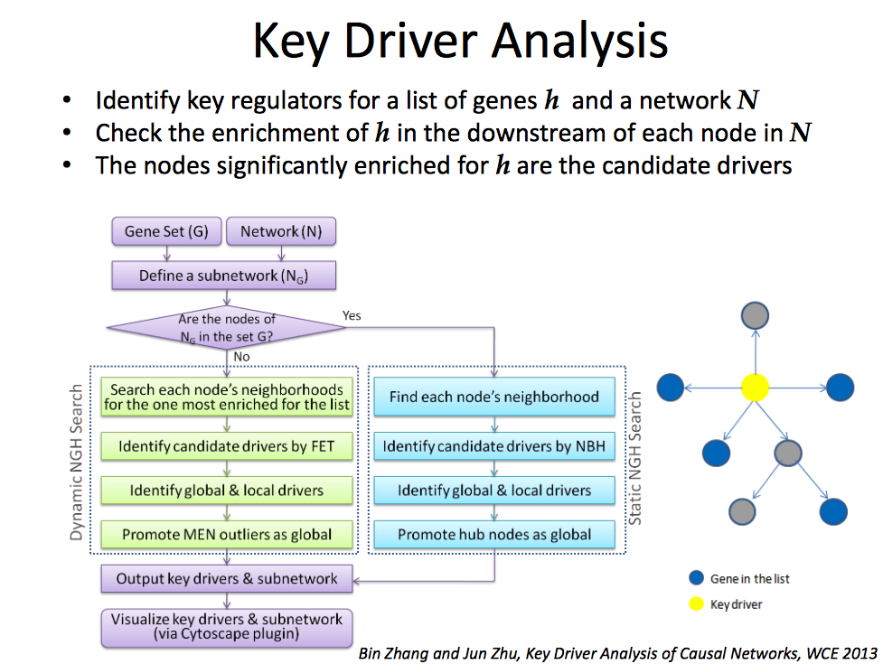
Bin Zhang
http://research.mssm.edu/multiscalenetwork/pdf/BinZhang_Lecture1_Mutiscale-Networks.pdf

Slide 10
Undirected Key Drivers
Network | RASopathy Gene Nearest Neighbor Layer | n KDs | Key Drivers
PF_normal_links_space_delimited.txt | 2 | 1 | SYT1
PF_normal_links_space_delimited.txt | 3 | 0 | NA
PF_AD_links_for_cytoscape.txt | 2 | 14 | PCID2, ARMET, CHD9, CMAS, Contig25597, ENST000002, HSS0026478, MLKL, ABHD3, NRIP2, SCAMP1, AK023526, SMCHD1, VEGF
PF_AD_links_for_cytoscape.txt | 3 | 2 | TPST1, Contig25809
omental_links_space_delimited.txt | 2 | 33 | Contig55973_RC, AL157455, ATP13A3, C5orf42, Contig25809_RC, Contig34043_RC, Contig35522_RC, Contig40647_RC, Contig46411_RC, Contig63302_RC, CSNK1A1, ENST00000254279, ENST00000274652, FMNL2, MRAP, HSS00341523, IRF8, MSL3L2, PCDHAC1, MYEF2, NM_016275, PGD, RALB, RP5-1000E10.4, SLC12A2, vSMCHD1, TLK1, WIPI1, XM_116156, ZNF148, AK024918, AK090686, AK092571
omental_links_space_delimited.txt | 3 | 14 | AK056431, AKAP11, CES1, CCDC55, CNN3, Contig56096, TMF1, HSS00094841, HSS00149426, ZNF616, IL17D, KRBA2, MOBKL1A, OXCT, PTBP2
ileum_links_space_delimited.txt | 2 | 4 | CCNE2, DHRS12, SOCS5, TBC1D10C
ileum_links_space_delimited.txt | 3 | 0 | NA
delimited_risk_network.txt | 2 | 1 | SOS2
delimited_risk_network.txt | 3 | 2 | ATP11B
delimited_pan_intestine_network.txt | 2 | 1 | VPS4B
delimited_pan_intestine_network.txt | 3 | 1 | MTMR9
delimited_blood_network.txt | 2 | 2 | DNAJB1, ZSCAN30
delimited_blood_network.txt | 3 | 2 | EIF4B, SRFBP1
Notes:
Email from Eric: don’t go past two or three layers in the network

Slide 11
Directed Key Drivers
Network | RASopathy Gene Nearest Neighbor Layer | n KDs | Key Drivers
PF_normal_links_space_delimited.txt | 2 | 0 | NA
PF_normal_links_space_delimited.txt | 3 | 0 | NA
PF_AD_links_for_cytoscape.txt | 2 | 0 | NA
PF_AD_links_for_cytoscape.txt | 3 | 0 | NA
omental_links_space_delimited.txt | 2 | 0 | NA
omental_links_space_delimited.txt | 3 | 0 | NA
ileum_links_space_delimited.txt | 2 | 0 | NA
ileum_links_space_delimited.txt | 3 | 0 | NA
delimited_risk_network.txt | 2 | 0 | NA
delimited_risk_network.txt | 3 | 0 | NA
delimited_pan_intestine_network.txt | 2 | 0 | NA
delimited_pan_intestine_network.txt | 3 | 0 | NA
delimited_blood_network.txt | 2 | 0 | NA
delimited_blood_network.txt | 3 | 0 | NA

Slide 12
Subnetwork Enrichment
http://amp.pharm.mssm.edu/Enrichr/enrich#
(Avi Ma’ayan lab)
Extracted enrichment in the subnetworks from a variety of databases:
GO (Biological Process, Molecular function)
KEGG
MSigDB Computational
Connectivity Map (drugs)
Gene Expression Omnibus Drug perturbations (Ma’ayan lab) (drugs)
NextBio?

Slide 13
Next Steps
Procuring additional cancer networks
Lung & colon cancer
Test for whether “network of interest was conserved/enriched in other networks of interest (say from different tissues)”
Test for enrichment in various databases consistent across tissue types/networks
Relate drugs screen to subnetworks (?)
How do key driver nodes fit into this?

